Slide 1
Lab rules
Wear goggles and especially gloves
Clean up benchtop and throw away your wastes (tissues, paper towels, papers, etc.)
Put chemicals back to cabinet in alphabetical order. Never leave them on the desk
Clean the balance and its surroundings using ethanol, in case of spill
Clean the quartz tube, o-rings, shafts of FZ furnace after use. Apply some grease on the shaft after cleaning
Label your samples in a sample box

Slide 2
Lab rules
Turn off x-ray power, close the chilled water valve on the ceiling
Put broken quartz/glass, heating elements, crucibles into hazardous waste bucket
Pour waste acid into waste acid bottle in the hood and transfer it to the plastic container when it’s full
Close oxygen and butane valves after done with quartz sealing.Close the valve on oxygen cylinder
Empty the water tank of the tile cutter and also the one for diamond blade saw

Slide 3
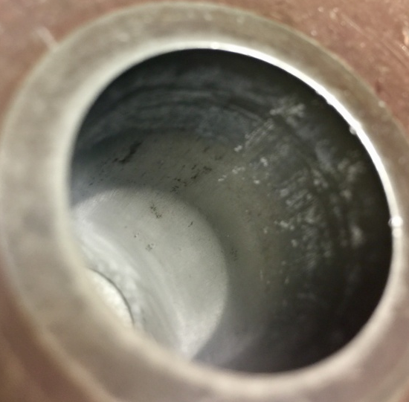
Lab rules
Soak used mortar and pestle using HNO3:H2O = 1:1 inside the hood overnight. Dry them and leave them under the polishing table
Clean the area in front of the furnaces, do not leave your sample there
Clean the press dies after use. In case of sticky materials, use abrasive scrubber/sand paper to gently remove the material on the wall and rinse with ethanol.
Put small pieces of press dies into
plastic container
Example of poorly cleaned press die

Slide 4
Lab rules
Heating rate of furnaces should be less than 200C/h. But furnaces with Mo silicide heating elements can be heated much faster.
Double check the program of furnaces. Check the status of furnace frequently after it is set to run. Sometimes heating elements break.
Do communicate with each other and use the furnaces efficiently. For example, you can sinter several pellets in one furnace with similar sintering T and sequence. Try not to use Mo silicide furnaces for T<1400 C sintering and leave them for T>1400C sintering.
Lead (or any toxic elements) containing samples should only be sintered in the furnace inside the hood of chemistry room
Use thermal blocks to block both ends of tube furnace for high temperature sintering
Never flip chemical bottle lid on top of open bottle (dust might fall into bottle)
To remove gloves, flip it inside out by pulling at the bottom opening and then throw away

Slide 5
Lab rules
make sure all gas cylinders are secured to a wall/fixed stand by straps/chains at all times
- check furnaces regularly ( heating elements maybe broken etc)
- relax the hydraulic press after use, otherwise the oil will leak
- don't clean plastics with acetone ( use ethanol )
- when using volatile chemicals ( I2, concentrated acids etc) , open the bottles only in the fume hood
- turn off micsroscpe and hot plate after use ( keep both clean, don't leave wax on hot plate)
- remove gloves when using the xrd computer
- use dryolites/desiccant tablets for hygroscopic samples

Slide 6
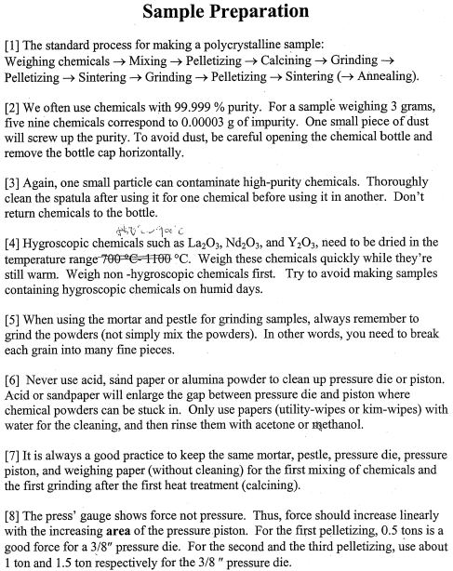

Slide 7
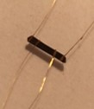
Transition metal dichalcogenide Xtals are soft/weak, so better to make a platform where electric leads (Au wires) are first attached.
Voltage contacts should be mostly on the side of the Xtal.
Each current contact should cover the entire end.
Au wires should have been annealed with match/lighter.

Slide 8
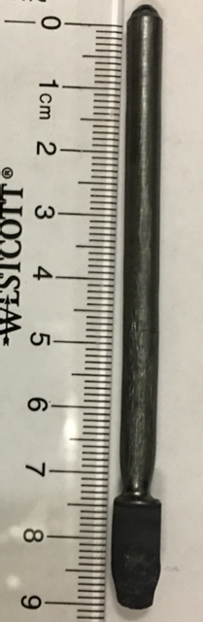
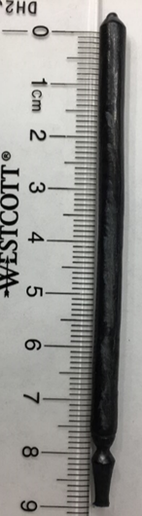
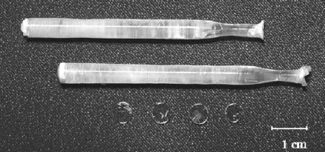
FZ crystal growth
Tips for good crystal growth:
Strong and high density feed rod
Good seed crystal and anti-tapered growth at the beginning
Stable and uniform growth
Adjust parameters such as heating power and rotation speed super-slowly with a proper prediction of what will happen 20-30 minutes later
If strange shapes form on feedrod during growth, lower rotation speed may help to melt it
Necking in the following picture in the beginning of FZ growth is important to select one Xtal orientation.
You can use pressure to suppress In oxide evaporation. In oxide evaporation can be different between oxygen and air. Pressure fluctuation can be also an important parameter that we usually do not consider. Obviously air (from compressor) pressure fluctuation is a lot more than O2 (from a tank) pressure fluctuation. This pressure fluctuation can be positive or negative - a little like thermal fluctuation.
It is a good idea to vary 2-4 parameters (growth speed, pressure, air/O2 etc) during one growth, so one can compare the effect of various parameters.

Slide 9
Gas cylinder regulator installation
To prevent contamination of gas in the cylinder, especially for high purity gas:
Connect the regulator to a new cylinder
First open the regulator valve fully.
Open the main valve of the cylinder, let the gas flush through the regulator for 5 sec
Close the regulator valve
Close the main valve of the cylinder

Slide 10
Forming gas
Gas flow
Standard pressure for gas flow is 10 psi
Check all the valves along the pipeline when you find there is no bubbles, and also make sure the rubber stopper is sealed tight. Use leakage detecting fluid to check all the connections.
Adjust the flow valve to make it 1 bubble per second. Watch the flow at RT as well as high T.
When using forming gas for the LFZ, do Ar flow first to flush the chamber.
When using forming gas for annealing, make sure the tube furnace is at RT.

Slide 11
Oxygen annealing furnace
Be super careful when using this unique high pressure oxygen annealing furnace
Because this cylinder is also connected to the L-FZ, make sure the valve to the L-FZ is closed before apply HP O2 into the chamber
Do flushing at ~15 bar 3~4 times
Do not over tighten the valves
Close the plastic shield
Do not stay above 900 C for long time
Write down the sequence in the log book

Slide 12
Using HP gas for FZ
Make sure the lower and upper shafts are tighten before applying HP gas, also tighten all the O-rings and screws
Release the pressure completely before loose any of screws
Monitor the pressure gauge all the time
In the case of severe evaporation, remove and clean the pipeline and filter after the growth

Slide 13
Contamination of chemicals
Chemicals are expensive, especially high purity ones
High purity 5N can be easily screw up by even dusts on bottle lid
Do not flip lid over the bottle after opening, move the lid to the side and then flip, place the lid upside down on other surface. Reverse the process to close the bottle
Use clean A4 paper to make a clean working surface when doing sample grinding in mortar
After pressing the pellet, scrape off the side surface that changed color with razor blade. That’s probably leftover material from previous use of press die
Highest purity of chemicals that we can purchase is five nines (10 ppm impurities), so the samples that we synthesize have often >100 ppm impurities. A good fraction of the impurities (about 1/4) is Fe oxides. These Fe impurities (often come from pressure die) can be detrimental to various magnetic measurements, so one have to be super-careful not to spread Fe oxide powders anywhere (such as working benches) in the lab.

Slide 14
Standard lab goods
J-B Weld 50132 PlasticWeld Quick-Setting Epoxy Syringe - Dries Off-White - 25 ml, Strength 4400 PSI

Slide 15
Reference book
Always check the toxicity of new chemicals in the “Hawley's condensed chemical dictionary”

